Slide 1
A Trip Between Borders: Exploring Culture & Heritage
The
Design Thinking
Process
Mrs. Welsh

Slide 2
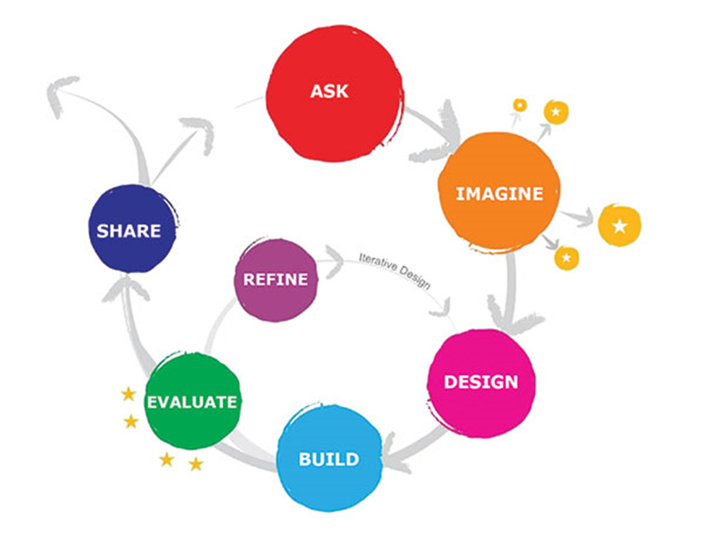
The Design Thinking
Process
Unit Expectations
Complete all steps included in the design thinking process as they are presented.
Complete homework (Required to move onto next step in the process)
Complete all notes
Complete all sketches and planning
Give your BEST effort, without copying someone else's work.
Ask Questions!!
Collaborate with your classmate in a respectful manner at all times.

Slide 3
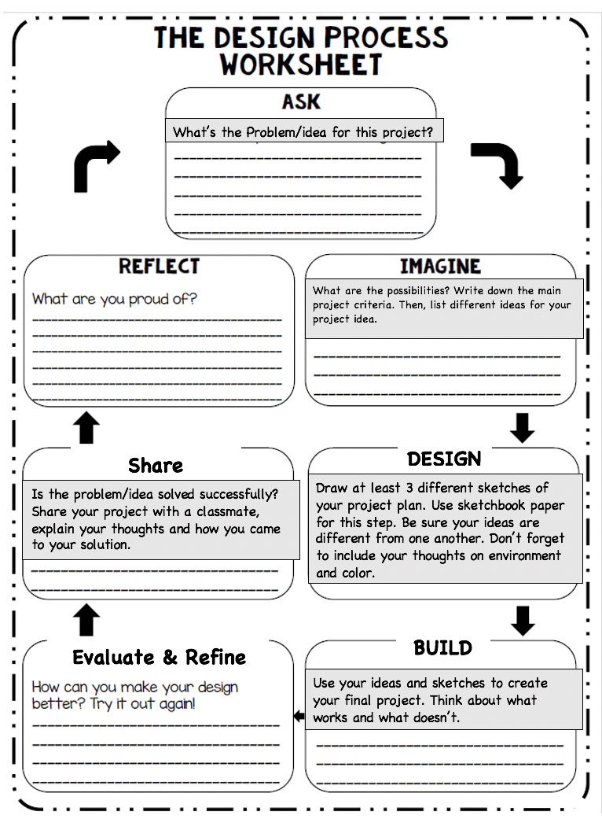
What are we doing?
You will engage with a 7 step Design Thinking process, to develop and create a mixed media work of art based on your culture and a peer’s culture different from yours.
You will learn about and use the 7 step Design Thinking process to investigate your own culture and share your cultural findings with a classmate.
You will learn about mixed media art techniques and processes.
You will design a work of art that represents your culture with your classmate’s culture.
Your artwork will be completed in mixed media techniques and processes.

Slide 4
Introduction to the Design Thinking Process
Explain student work packets
Notes
Family Interview
Contemporary Artists Journal
Peer Share
Draw paper set 1
Drawing paper set 2
Art Critique Etiquette
Peer Critique
Artist Statement
Project Reflection
Desired Goal & Outcome
I want you to work each step of the design thinking process to get a more in-depth understanding and respect of your own culture and that of others.
I want you to create a well thought out and interesting work of art, using mixed media.

Slide 5
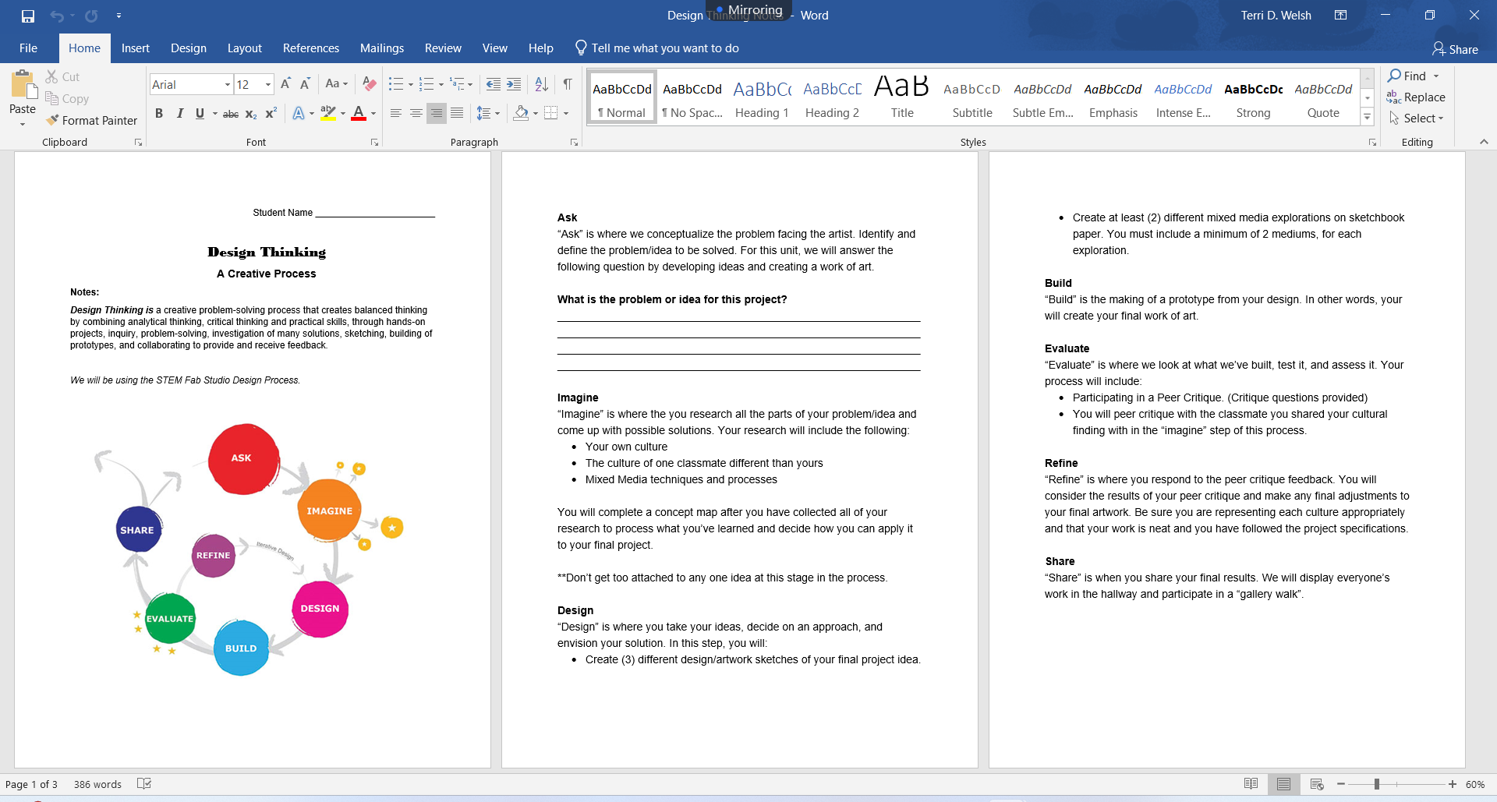
The Design Thinking Process
Overview of Notes:
The 7 Design Thinking Process Steps
What is the problem or idea for this project? (Write it down)
ASK
Step 1
The Problem or Idea Defined:
How can I create a mixed media work of art that represents my culture and a classmates culture together?

Slide 6
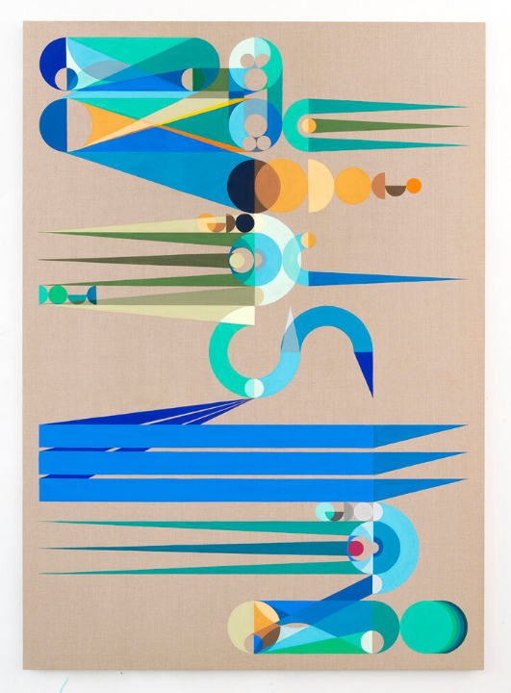
Contemporary Artist
Culture & Heritage
Eamon Ore-Giron
Use your journal notes packet to take notes on the artist. Use these questions to guide your discovery:
  What is an interesting fact about Eamon Ore-Giron?
  How does this artist use culture to create his works of art?
  How does the artist represent his cultural experiences in his works of art?
  What is something you find most interesting about the artist’s work?
  How do you think the artist uses colors and shapes to represent things about his culture?
Click here to view the artists WEBSITE
Click here to view the artists INTERVIEW
“Night Shade” by Eamon Ore-Giron, 2016

Slide 7
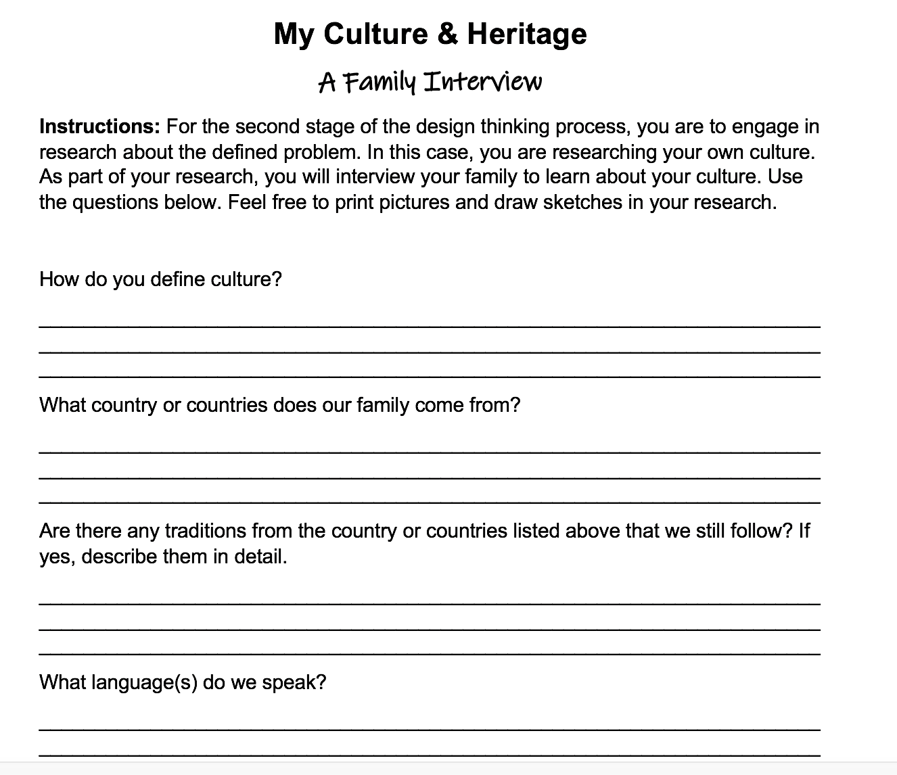
RESEARCH YOUR OWN CULTURE & SHARE
IMAGINE
Step 2
What is Culture?
A culture is a way of life of a group of people: the behaviors, beliefs, values, and symbols that they accept, generally without thinking about them, and that are passed along by communication and imitation from one generation to the next.
Culture includes things like food, language, clothing, tools, music, arts, customs, and beliefs.
In your packet: (Family Interviews)
Write down the definitions of culture and heritage, in your own words.
HOMEWORK!!!
Complete “My Culture & Heritage: A Family Interview” to the best of your ability, by interviewing a family member(s).
THIS IS REQUIRED TO MOVE FORWARD IN THIS PROJECT

Slide 8
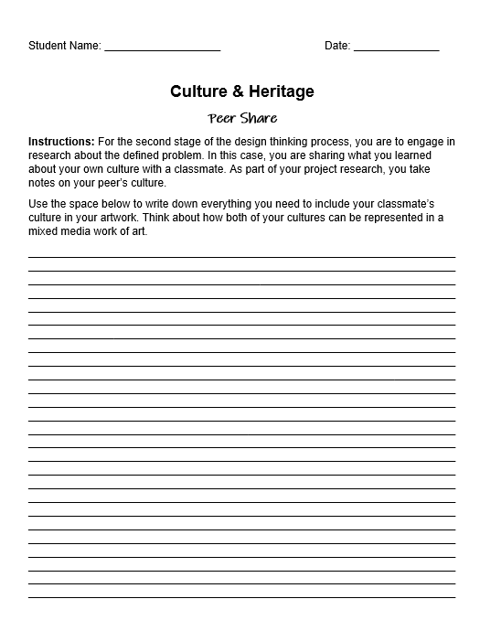
RESEARCH YOUR OWN CULTURE & SHARE
IMAGINE
Step 2 con’t.
COLLABORATION
Pair up with the classmate you have been given.
Complete the “Culture & Heritage Peer Share” activity. Take notes on each others culture so that you can plan your project with both cultures together.

Slide 9
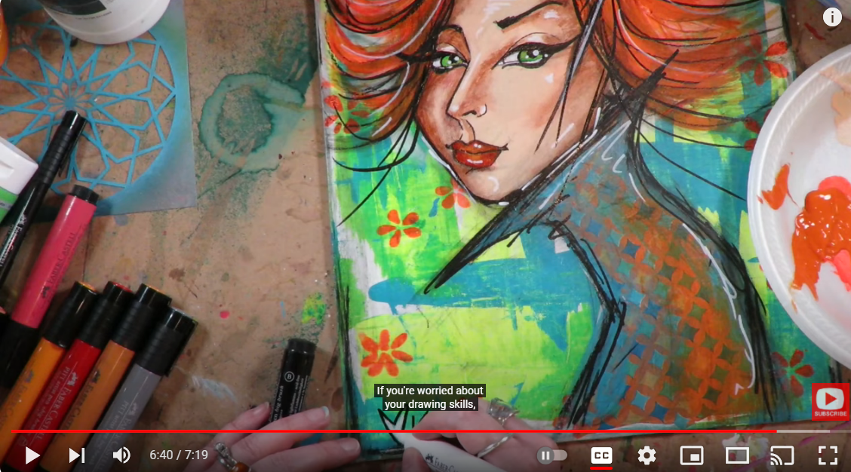
Intro to MIXED MEDIA TECHNIQUES & PROCESSES
INTRODUCTION TO MIXED MEDIA
Click here to watch
IMAGINE
Step 2 con’t.
Click here to view the artists INTERVIEW
EXPLORATION
Introduction to Mixed Media
Mixed media is a term used to describe artworks composed from a combination of different media or material.
Intro. Video
Intro to a Mixed Media Contemporary Artist
  Take Notes
  Research Your Own Mixed Media Artist
Njideka Akunyili Crosby
Use your journal notes packet to take notes on the artist. Use these questions to guide your discovery:
What is an interesting fact about Njideka Akunyili Crosby?
How does this artist create her artworks?
What is the inspiration for her mixed media choices?
Describe a technique or two that she uses to create her art works.
David Zwirner website
Click Here to view

Slide 10
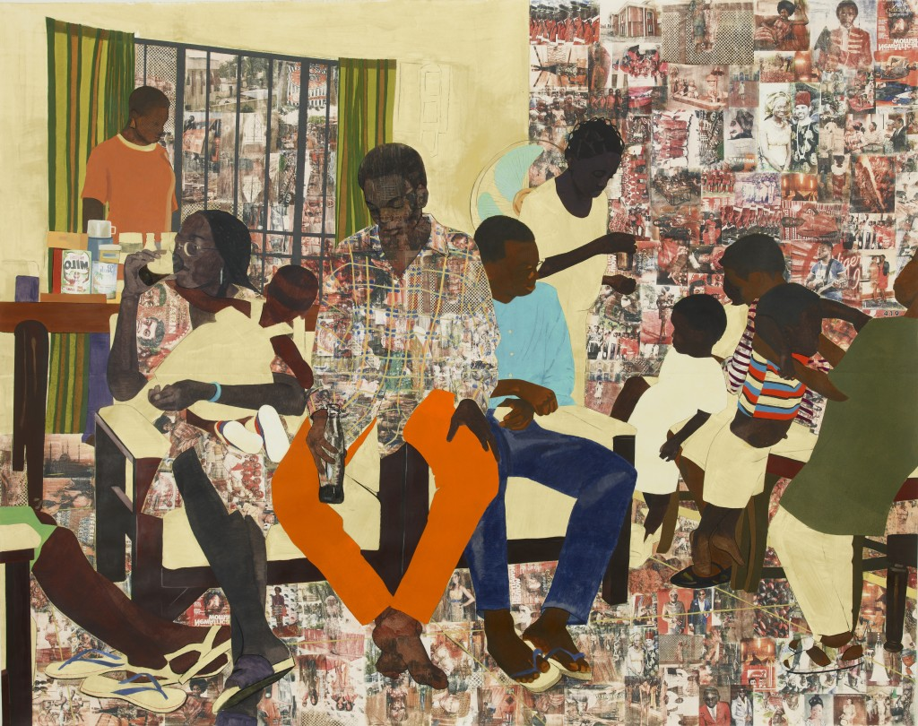
RESEARCH YOUR OWN MIXED MEDIA ARTIST
WHO DID YOU FIND????
IMAGINE
Step 2 con’t.
EXPLORATION
Review: Mixed media is a term used to describe artworks composed from a combination of different media or material.
Search on your own:
  Research Your Own Mixed Media Artist
  Take Notes in your packet
“5 Umezebi St., New Haven, Enugu” by Njideka Akunyili Crosby, 2012

Slide 11
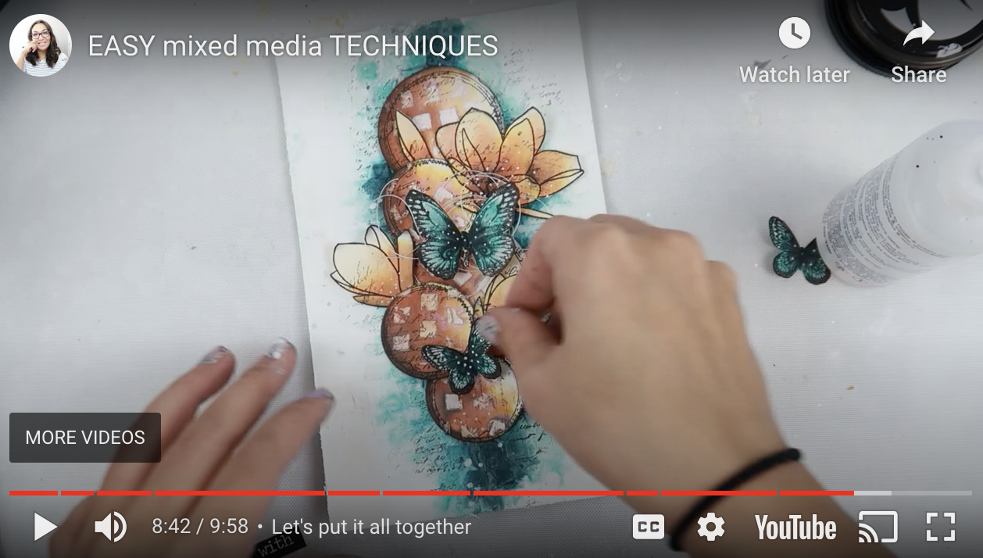
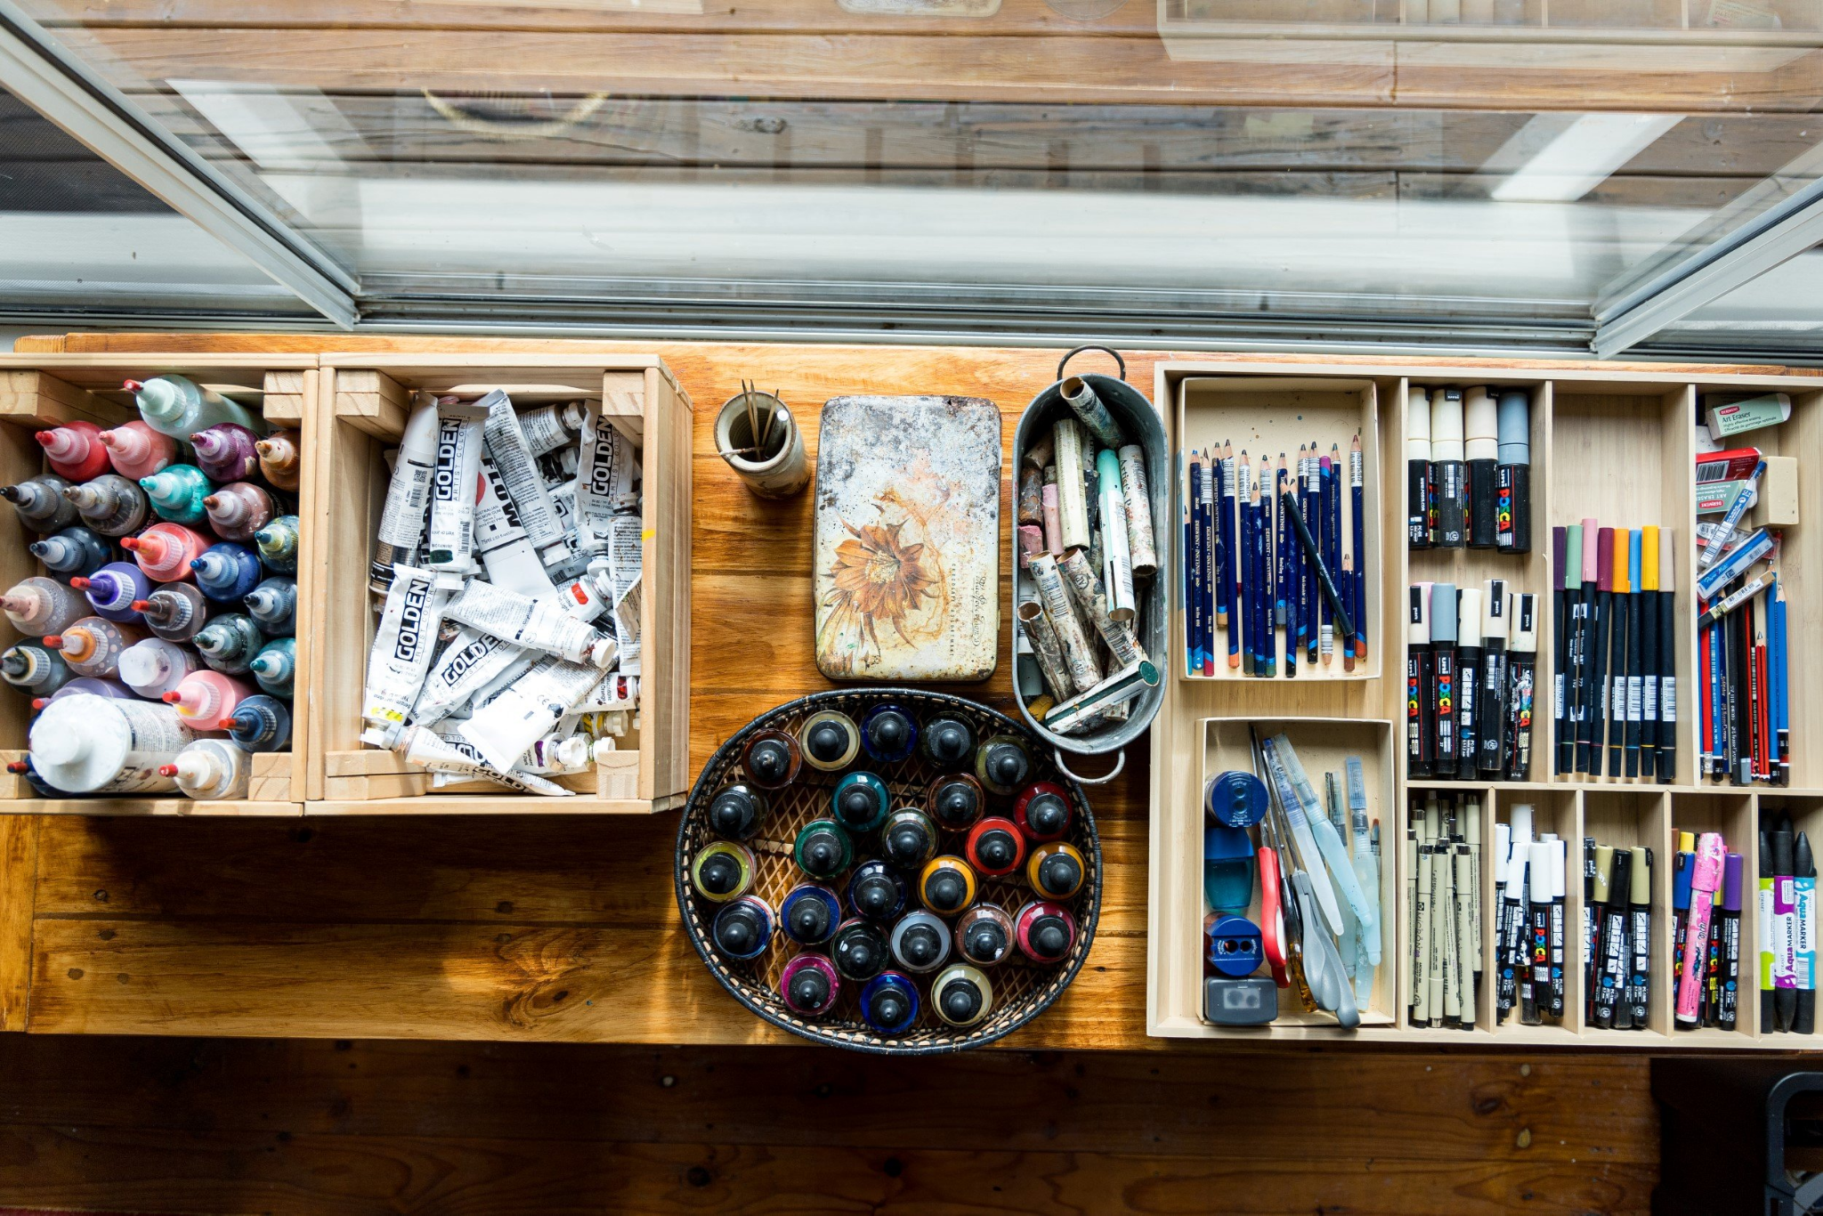
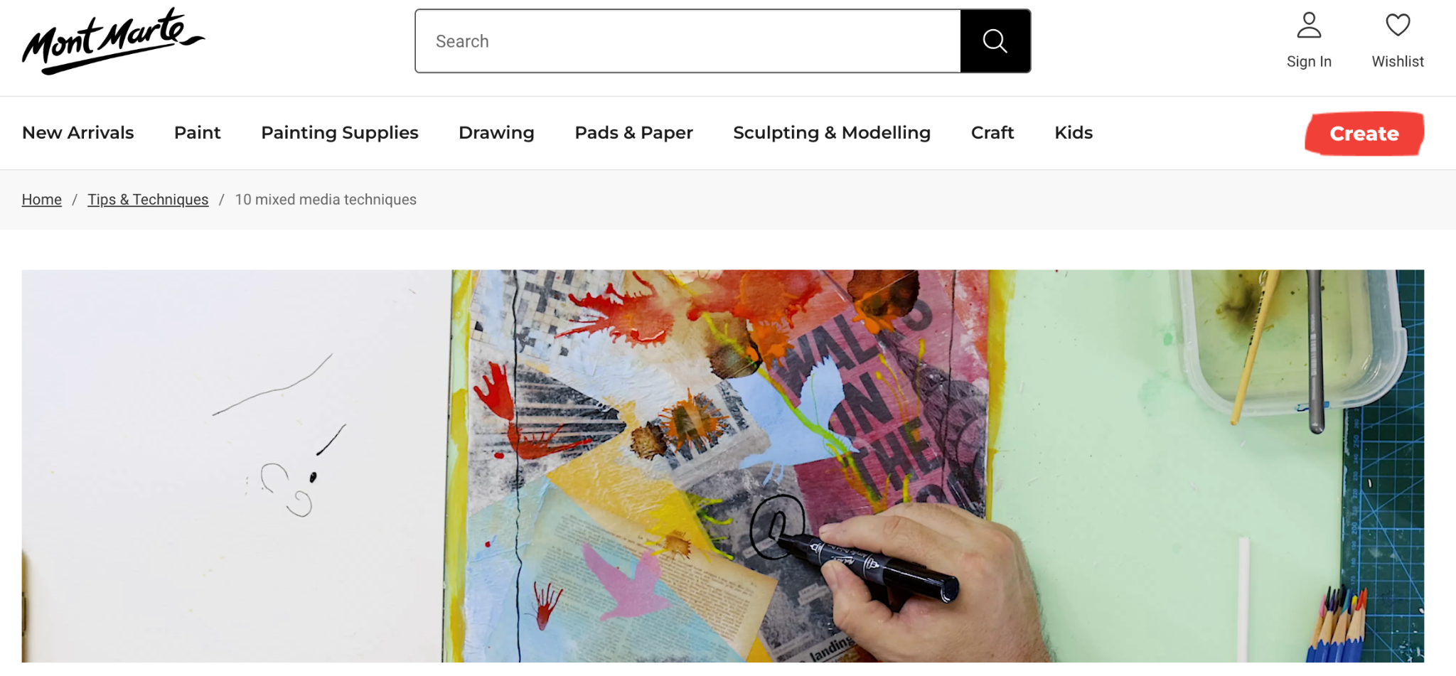
MAKE SENSE OF WHAT YOU HAVE LEARNED
EASY mixed media TECHNIQUES
Tiffany Solorio
Click Here to Watch
IMAGINE
Step 2 con’t.
MIXED MEDIA PRACTICE
Create 6-8 different mixed media practices, using demonstration and tutorial videos.
THESE SHOULD NOT BE A FULL PAGE PER PRACTICE!! No bigger than ½ page.
10 mixed media techniques
by
Mony Monte Global
Click Here to Watch

Slide 12
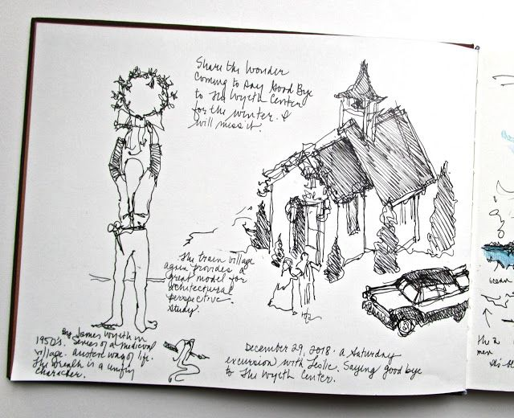
DEVELOP YOUR FINAL PROJECT IDEA
THINK ABOUT…
What is your defined problem/idea
What did you learn in your Family interview that you want to include in your final artwork?
What information from your Peer share notes (your classmate)
Mixed media practice (What materials do you like together?)
How can these materials be used and in what ways can they be used to best represent your culture and your classmates culture?
DESIGN
Step 3
Based on your research and Exploration
Create a minimum of 3 final project design ideas. (Sketches only, notes on media)
Use sketchbook paper
  You must include:
    Your culture
    Your classmate’s culture
    Mixed media techniques (Notes Only)

Slide 13
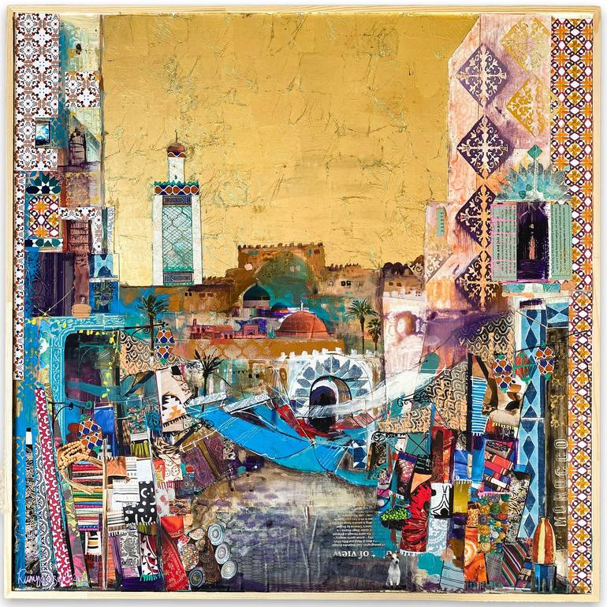
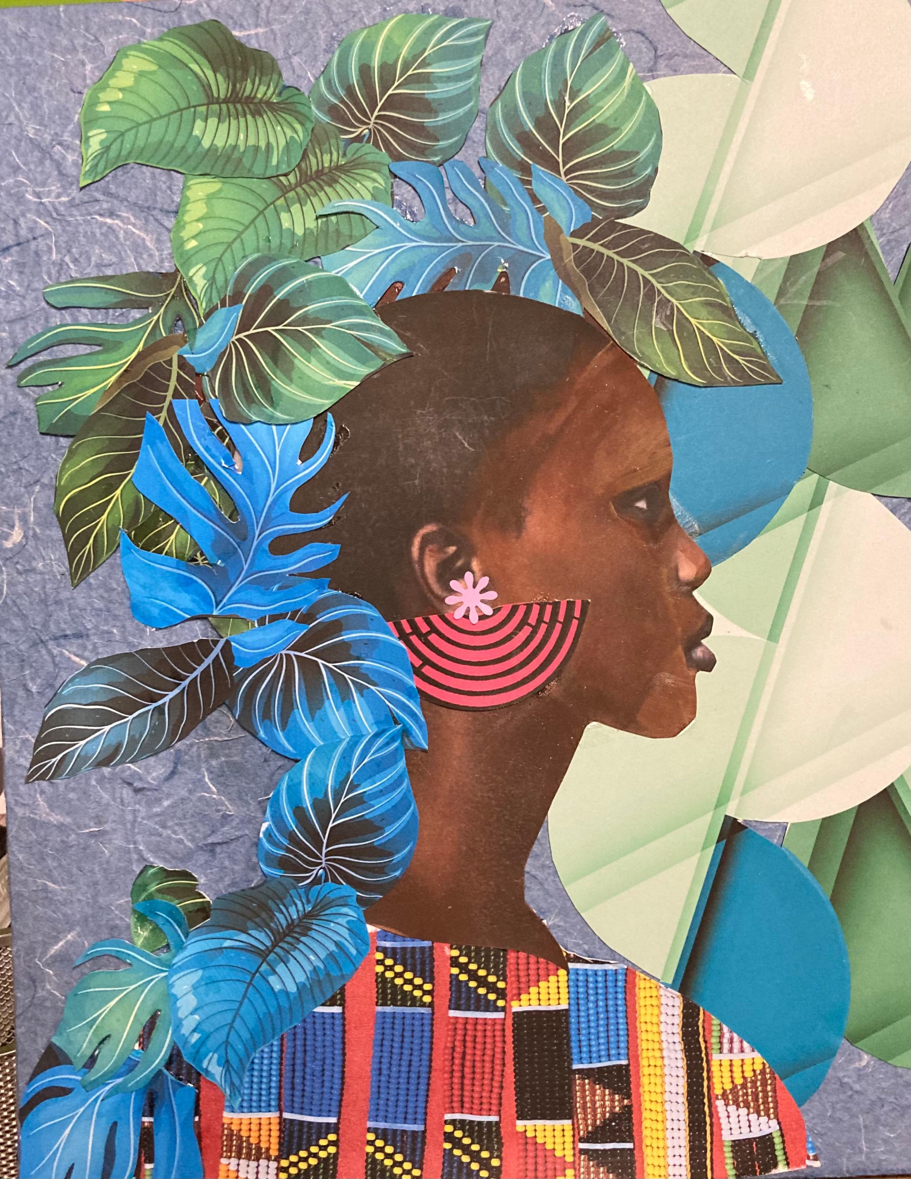
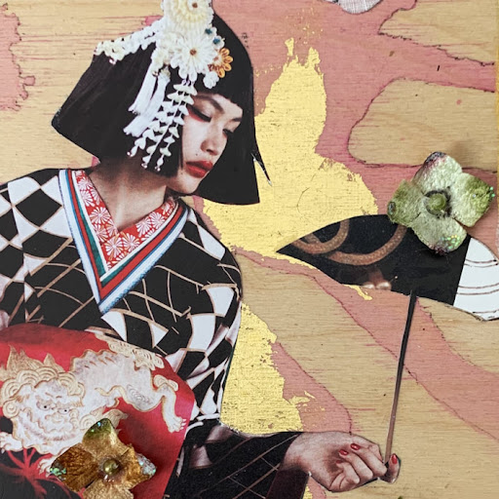
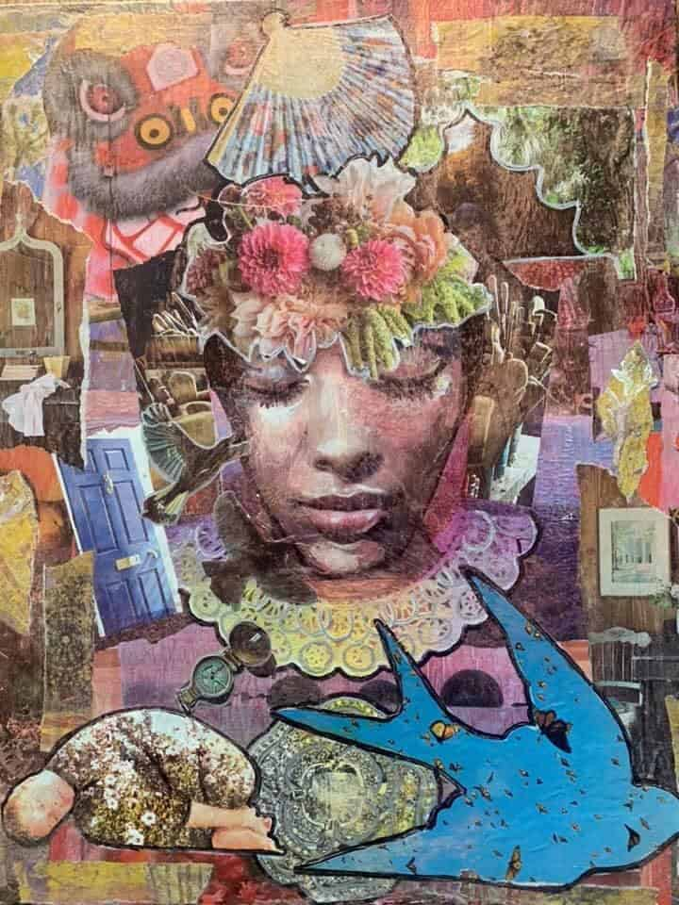
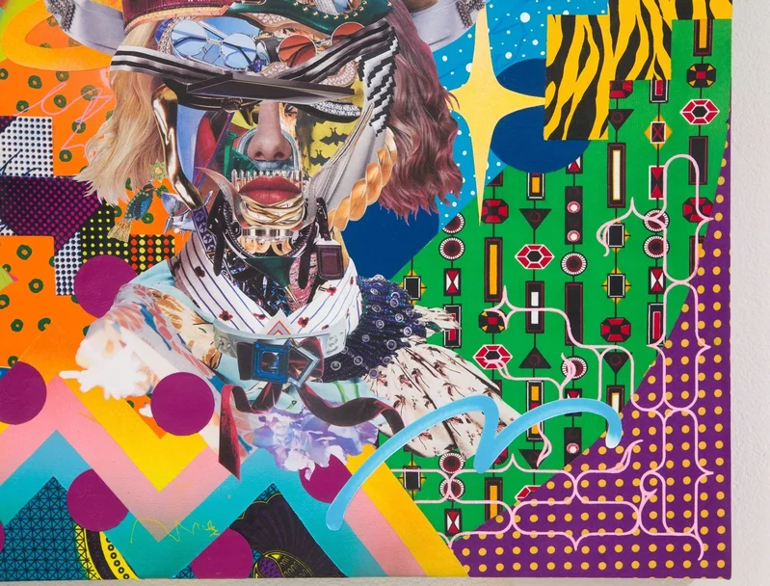
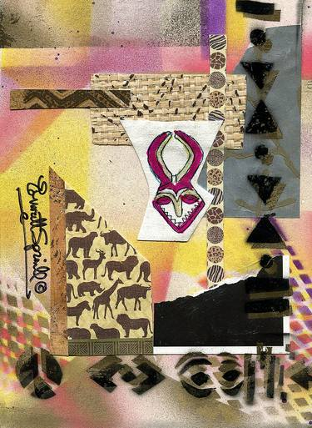
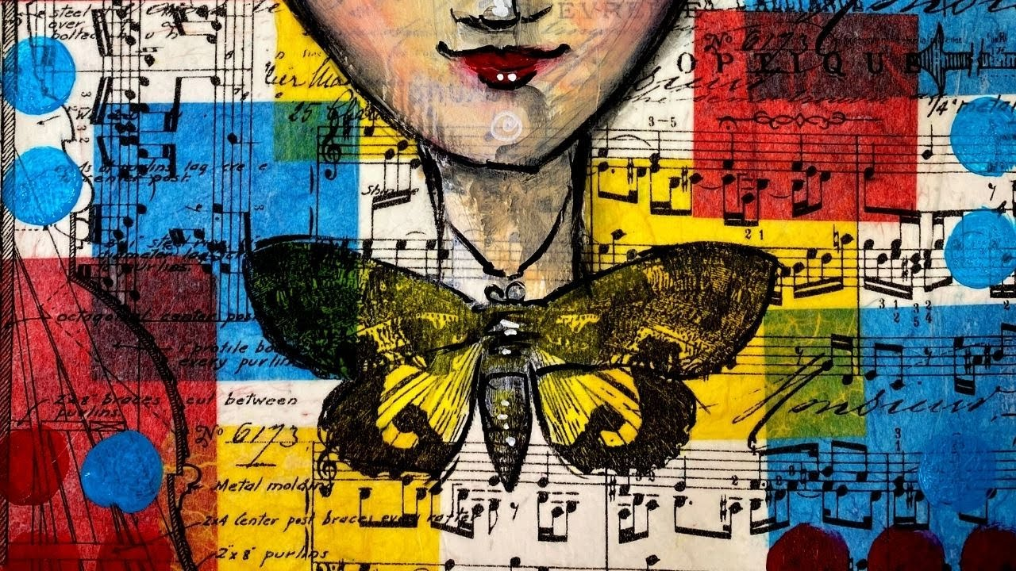
CREATE YOUR FINAL ARTWORK
BUILD
Step 4
Choose your best sketch idea
Create your final mixed media that represents your culture and a classmate’s culture together.
12X18 inch paper/Canvas

Slide 14
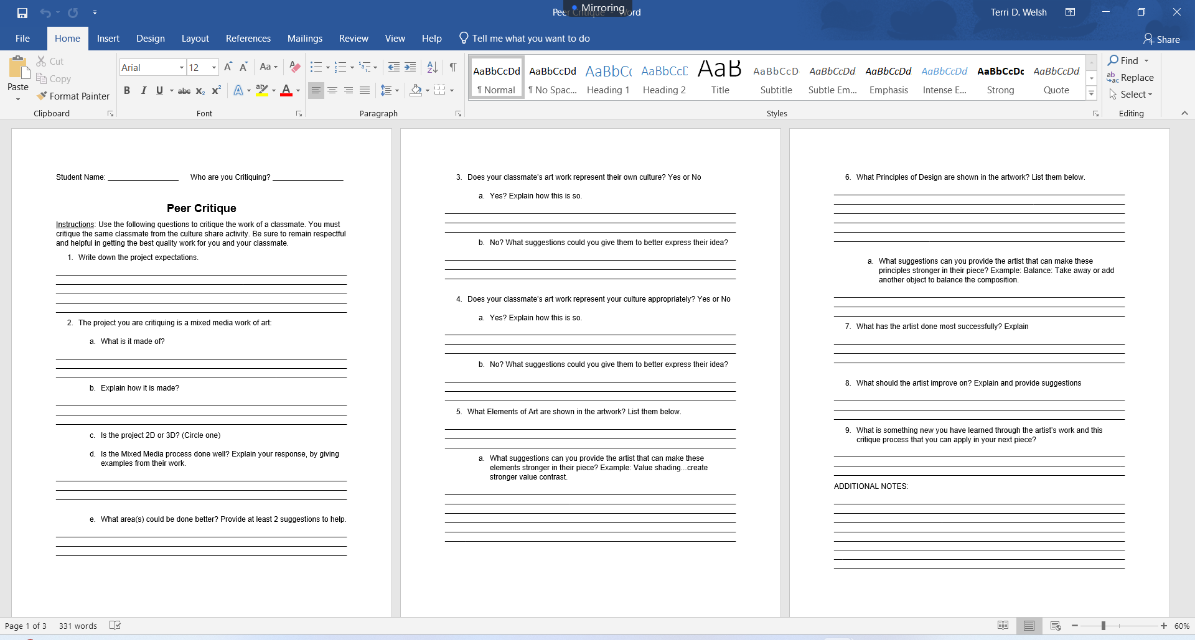
ASSESS EACH OTHER’s PROGRESS SO FAR
EVALUATE
Step 5
PEER CRITIQUE
Critique Etiquette
Peer Critique
REFINE
Step 6
MAKE ADJUSTMENTS & Artist Statement
Finalize your project
Write your Artist Statement

Slide 15
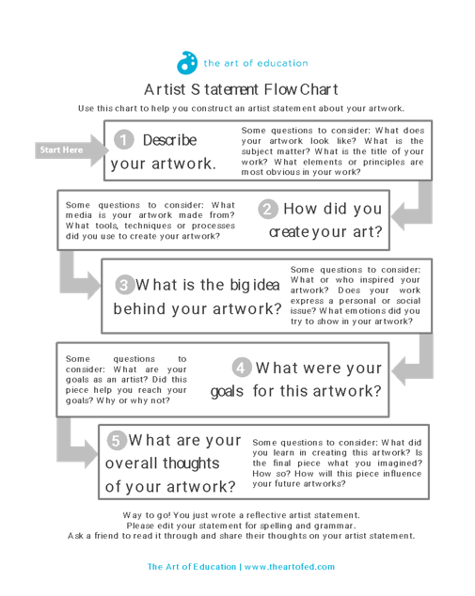
MAKE NEEDED ADJUSTMENTS
REFINE
Step 6
MAKE ADJUSTMENTS & Artist Statement
Finalize your project
Write your Artist Statement
TODAY IS THE LAST DAY TO WORK ON PROJECTS.
PROJECTS DUE AT THE END OF CLASS!!
Once you have completed your project, write your artist statement using the 5 prompts at the top of the page, then turn in your project and your folder to me. =)
TOMORROW = GALLERY WALK (Share)

Slide 16
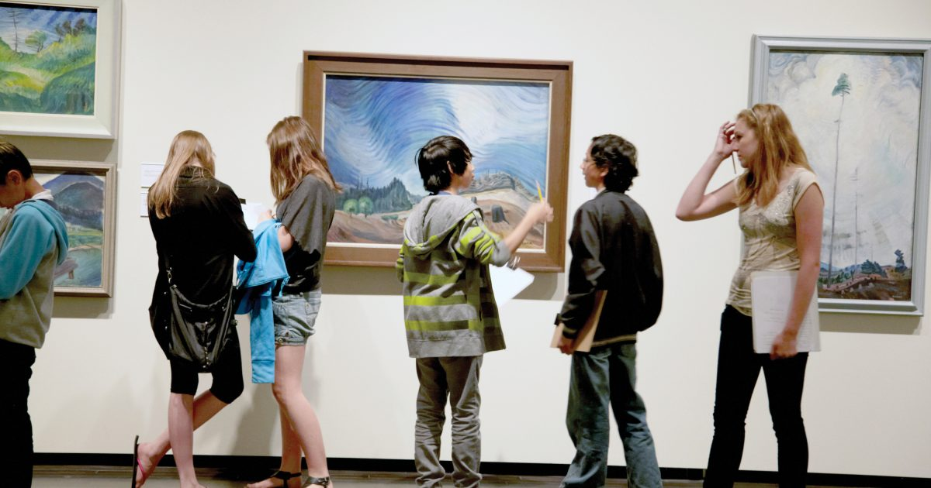
OBSERVE WHAT WE’VE ACCOMPLISHED
SHARE
Step 7
GALLERY WALK
Hang up all final artworks in the hallway.
Students spent time walking through and observing everyone's work.

Slide 17
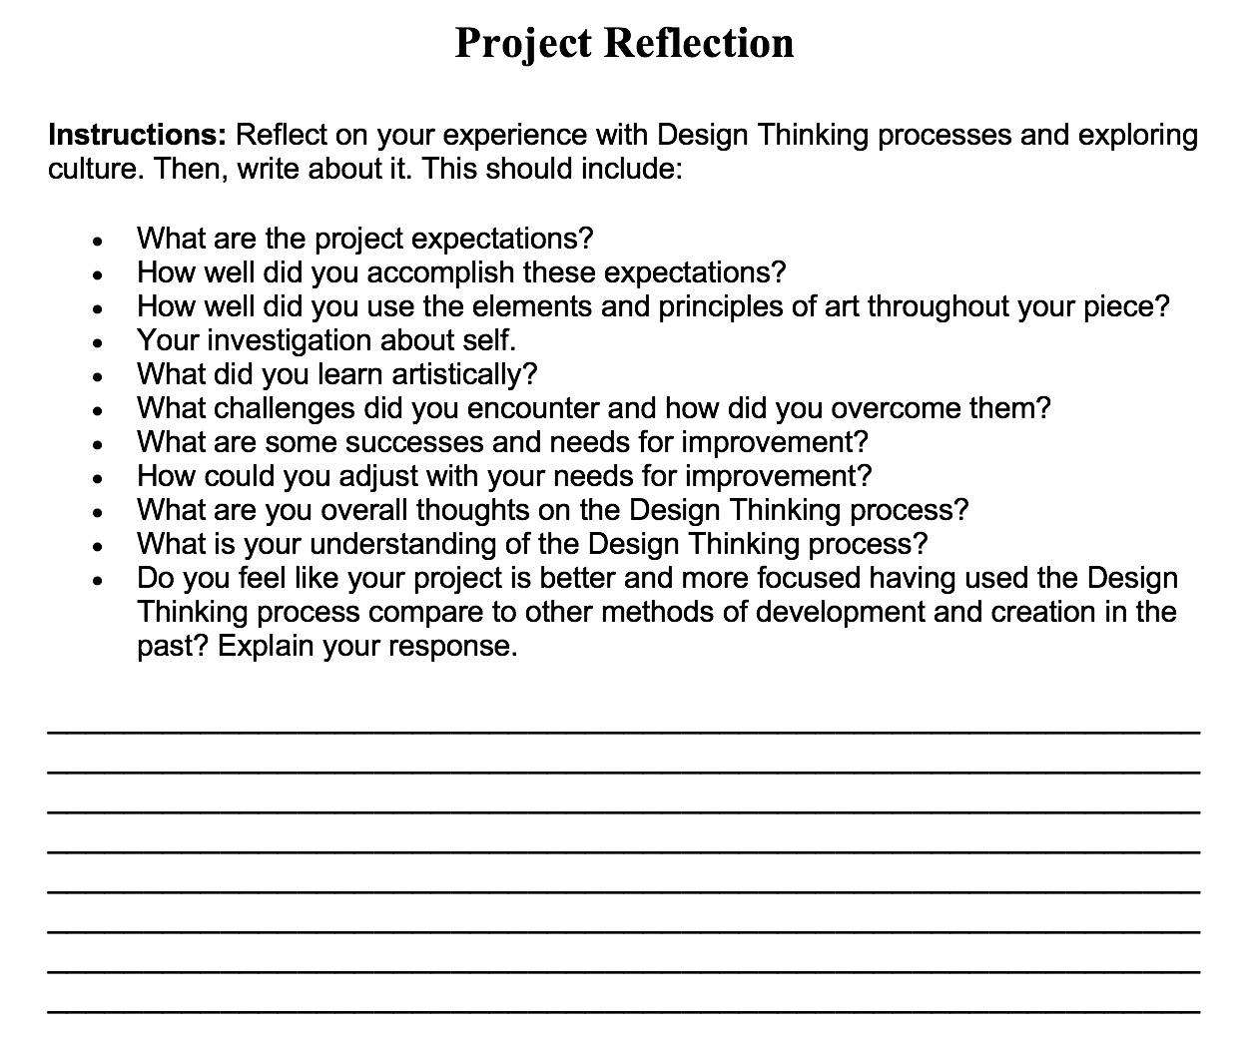
WRAP IT UP!!
PROJECT REFLECTION
Spend some time reflecting on each of the project steps, then
Write a reflection of your Design Thinking process experience.
  The 7 steps were:
    Ask: Define the project problem or idea
    Imagine: Research your culture, classmates culture, mixed media and artists associated with culture and mixed media
    Design: Develop 3 project ideas
    Build: Create your final project
    Evaluate: Peer Critique
    Refine: Make improvements
    Share: Gallery Walk/Reflection

