Slide 1
The Gumball Machine
The
Design Thinking
Process
Mini Project
Mrs. Welsh

Slide 2
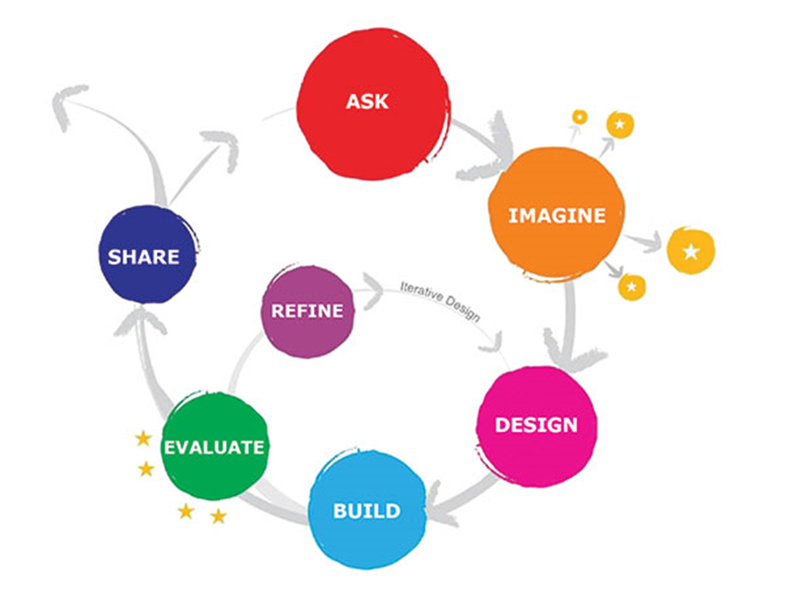
The Design Thinking
Process
Unit Expectations
Complete all steps included in the design thinking process as they are presented.
Complete all sketches and planning
Give your BEST effort, without copying someone else's work.
Ask Questions!!
Collaborate with your classmate in a respectful manner at all times.

Slide 3
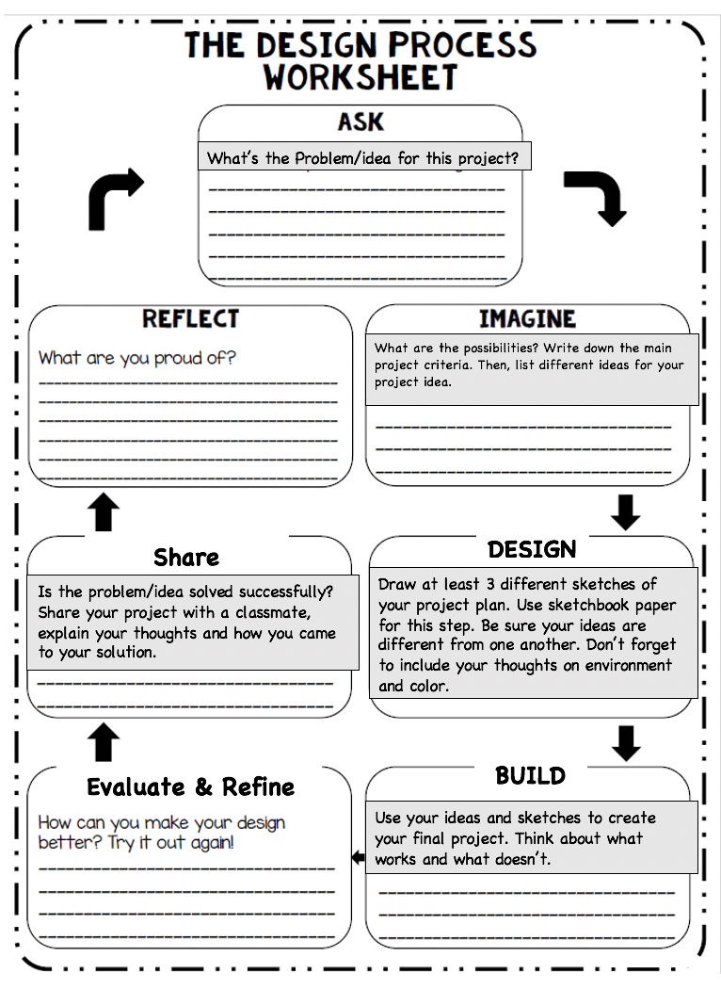
What are we doing?
You will engage with a 7 step Design Thinking process, to develop and create an interesting work of art.
You will learn about and use the 7 step Design Thinking process to investigate how to draw a gumball machine and fill it with anything about you and your family instead of gumballs.
You will complete your drawing by adding an environment for your gumball machine to sit in.
You will use colored pencils and/or watercolor paint to complete your drawing in color.

Slide 4
What is the Design Thinking Process?
Desired Goal & Outcome
I want you to work each step of the design thinking process to get a more in-depth understanding of how it works to create art successfully.
I want you to create a well thought out and interesting work of art.
I want you to follow the guidelines given.
Defined
Design Thinking is a creative problem-solving process that creates balanced thinking by combining analytical thinking, critical thinking, and practical skills through hands-on projects, inquiry, problem solving, investigation of many solutions, sketching, building of prototypes, and collaborating to provide and receive feedback.
WHAT???
Design is not just about how things look, but also about the careful planning and thinking that goes into creating them. Good design helps solve problems and make things enjoyable. We call this problem-solving process “Design Thinking.”

Slide 5
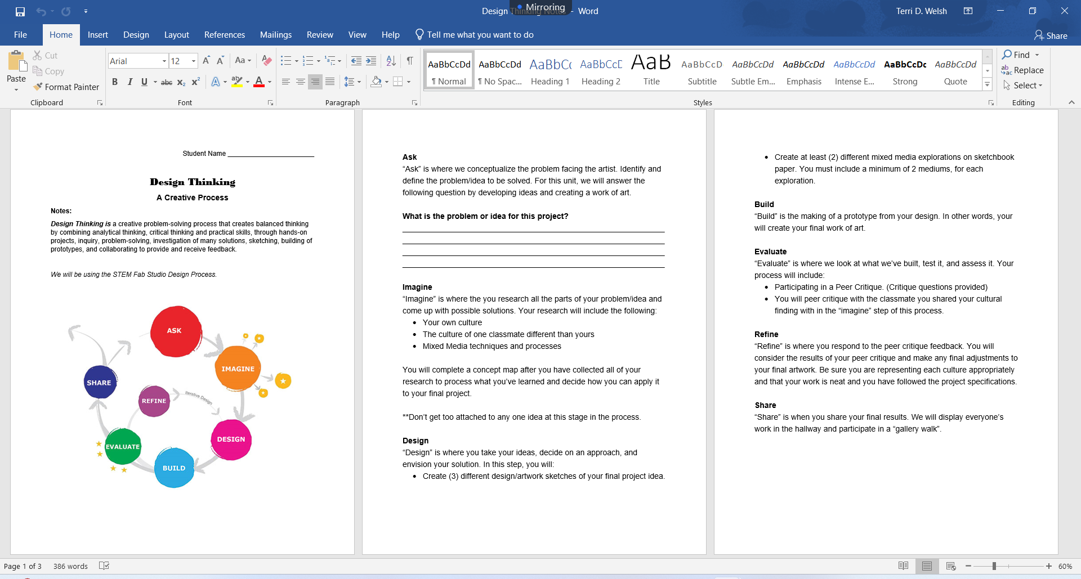
Desired
Project Outcomes
Desired Goal & Outcome
I want you to work each step of the design thinking process to get a more in-depth understanding of how it works to create art successfully.
I want you to create a well thought out and interesting work of art.
I want you to follow the guidelines given.

Slide 6
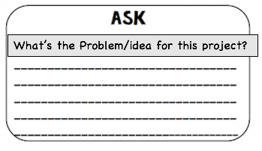
The Design Thinking Process
Overview of Notes:
The 7 Design Thinking Process Steps
What is the problem or idea for this project? (Write it down)
ASK
Step 1
The Problem or Idea Defined:
How can I create a work of art that illustrates a gumball machine filled with anything about me and my family instead of gumballs, place my gumball machine in a related environment, and complete my work with color?

Slide 7
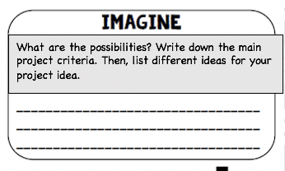
RESEARCH & GATHER INFORMATION
Research & Investigate!!!
What type/style of gumball machine?
What are things about myself and my family that I want to include? What is our story?
What kind of environment do I think fits my gumball machine and what’s inside?
How do I want to add color? Colored pencil or watercolor, or both? How will it be done?
IMAGINE
Step 2
What are the final project expectations (criteria) ?
I need a gumball machine filled with anything about myself and my family.
I need my gumball machine to have a background environment.
I need my final project to be completed in color.
My color options are colored pencil and watercolor paint.
THIS IS REQUIRED TO MOVE FORWARD IN THIS PROJECT

Slide 8
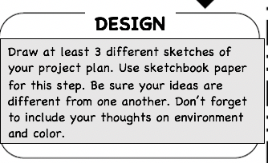
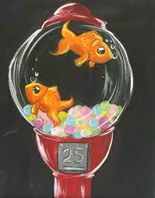
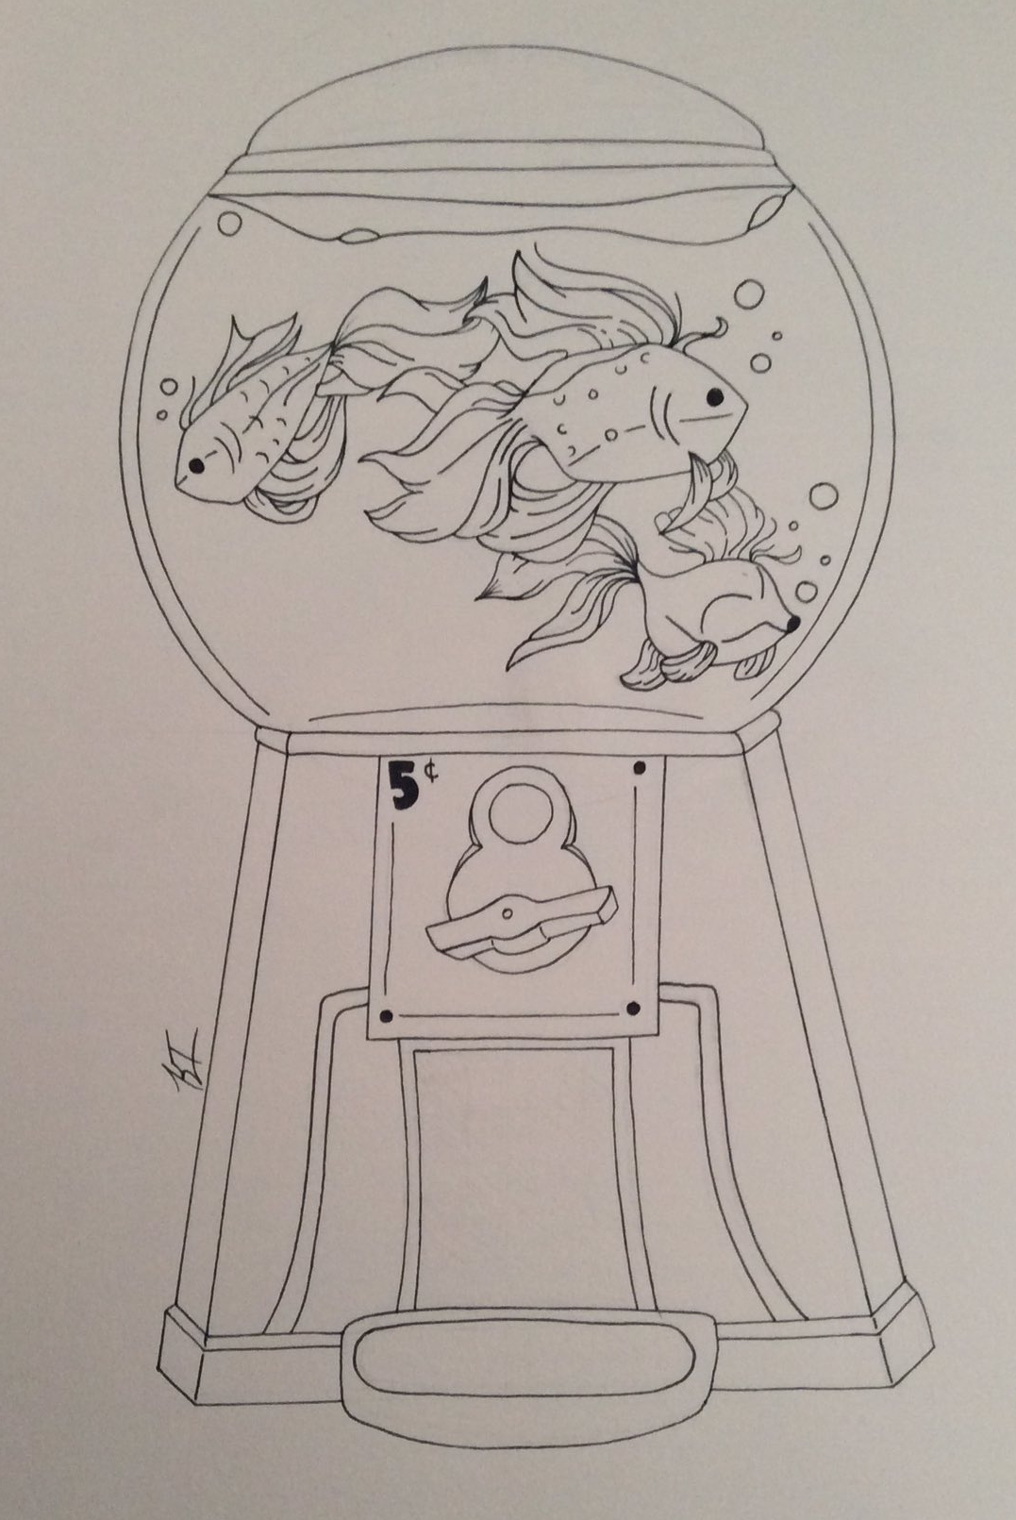
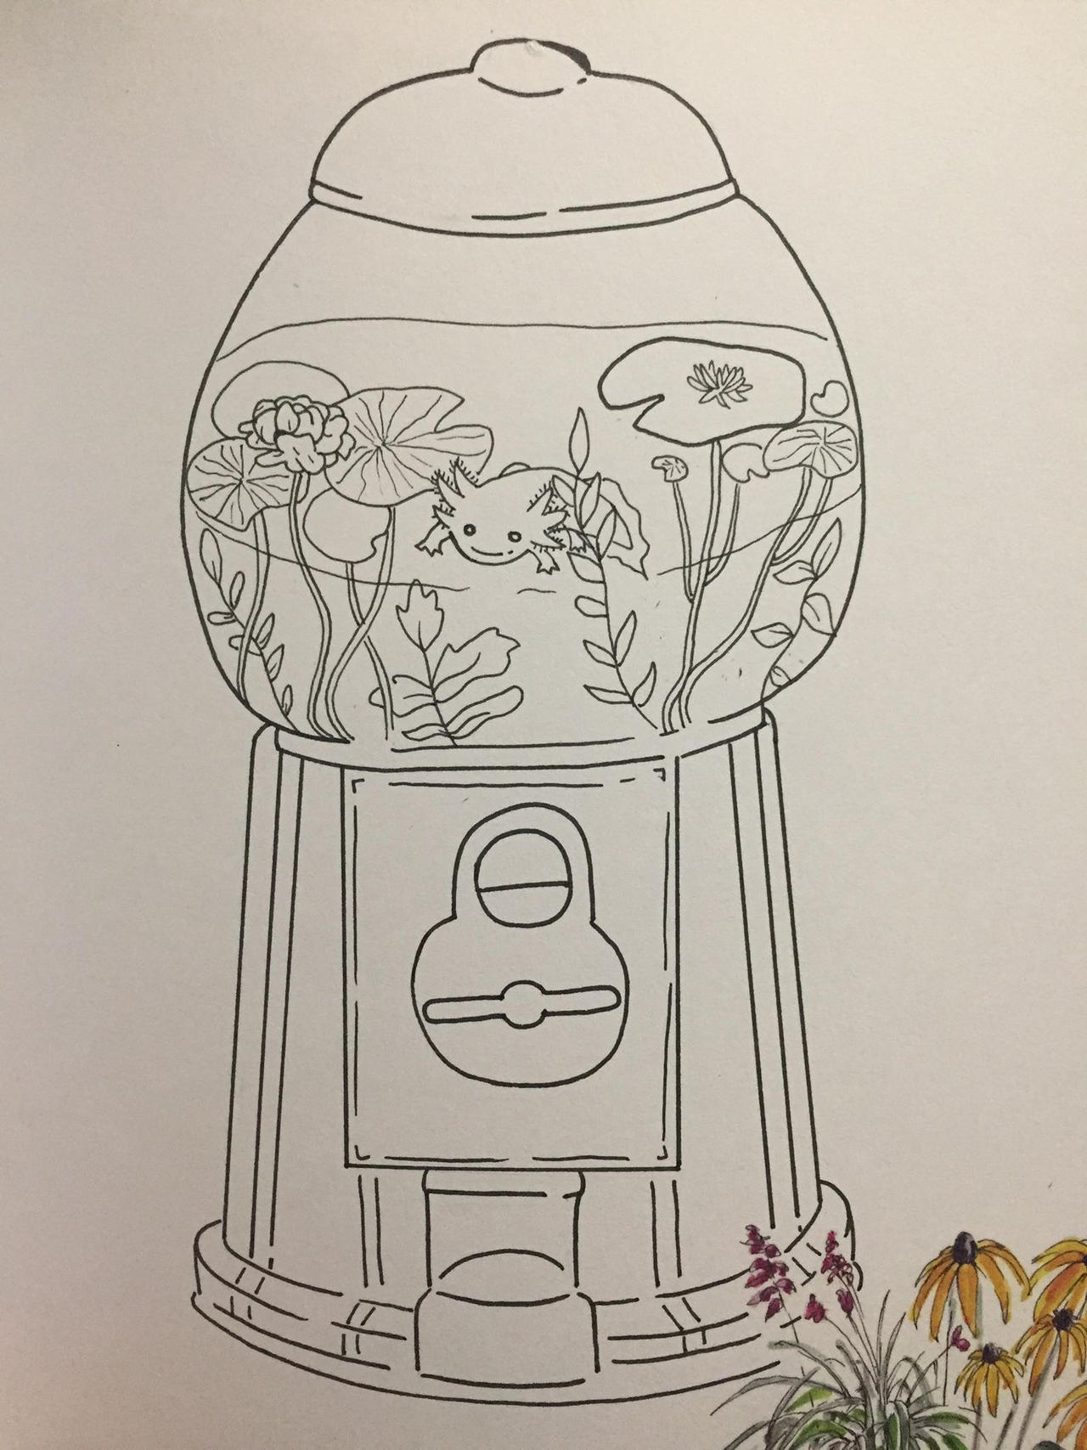
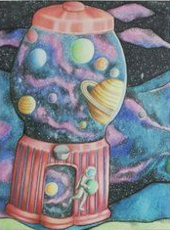
DEVELOP YOUR FINAL PROJECT IDEA
DESIGN
Step 3
Based on your research…
Create a minimum of 3 final project design ideas.
Use sketchbook paper
  You must include:
    Your gumball machine
    Items inside your gumball machine
    Your background environment
    Ideas on color
Sketches & Notes only!!!
This IS NOT a final project!

Slide 9
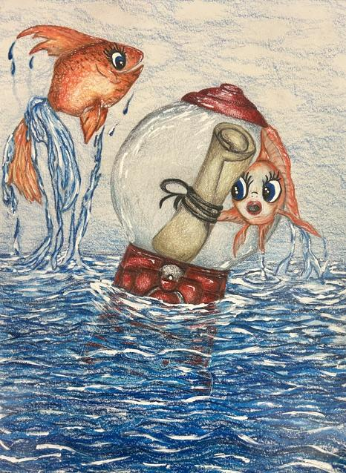
CREATE YOUR FINAL ARTWORK
BUILD
Step 4
Choose your best sketch idea
Create your final Gumball Machine project in color.
9X12 inch or 12X18 inch white paper

Slide 10
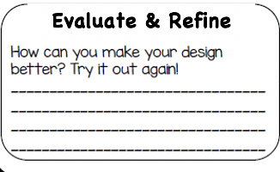
ASSESS & FINALIZE
YOUR PROJECT
EVALUATE
Step 5
Self-Critique
Closely look at the project/idea problem, and compare it to your ideas and your current project status. What is working? What is not working? How can you make it it’s bet?
REFINE
Step 6
MAKE ADJUSTMENTS & FINALIZE
Finalize your project

Slide 11
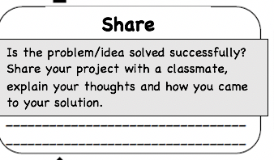

OBSERVE WHAT YOU’VE ACCOMPLISHED
SHARE
Step 7
Pair up & Share
Share your project with a classmate.
Explain your thoughts and how you came to your solution.
Both of you share with each other and write down your thoughts in the space provided about the overall project that has been shared with you.

Slide 12
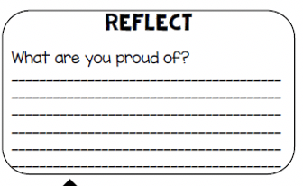
WRAP IT UP!!
PROJECT REFLECTION
Spend some time reflecting on each of the project steps, then
Write a reflection of your Design Thinking process experience and your final project.
  What are you most proud of in your final project? Explain why?
  How did the Design Thinking process help you to reach the best version of your project idea? (Your opinion)

